Slide 1

Working with Assistants Part 15: File Search Annotations

Slide 2
What’s Covered in This Session
Understanding File Search Annotations
Creating an Event Handler for streaming output
Updating the Event Handler
Cleaning Up the Annotations
Final Thoughts

Slide 3
Understanding File Search Annotations
Where Is My Stuff Coming From?
Notes:
https://platform.openai.com/docs/assistants/tools/code-interpreter/code-interpreter-beta

Slide 4
Assistant Tools
File Search
Code Interpreter
Function
Notes:
https://platform.openai.com/docs/api-reference/assistants/createAssistant#assistants-createassistant-tools

Slide 5
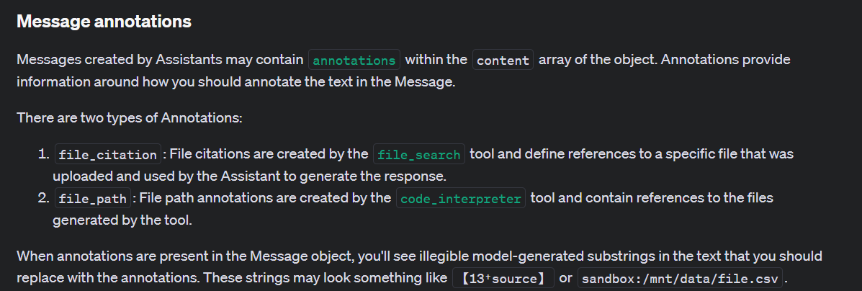
Notes:
https://platform.openai.com/docs/assistants/how-it-works/message-annotations

Slide 6
Using the Event Handler From the Documentation
Spoiler Alert: It Doesn’t Work Right
Notes:
https://platform.openai.com/docs/assistants/tools/file-search/step-5-create-a-run-and-check-the-output

Slide 7
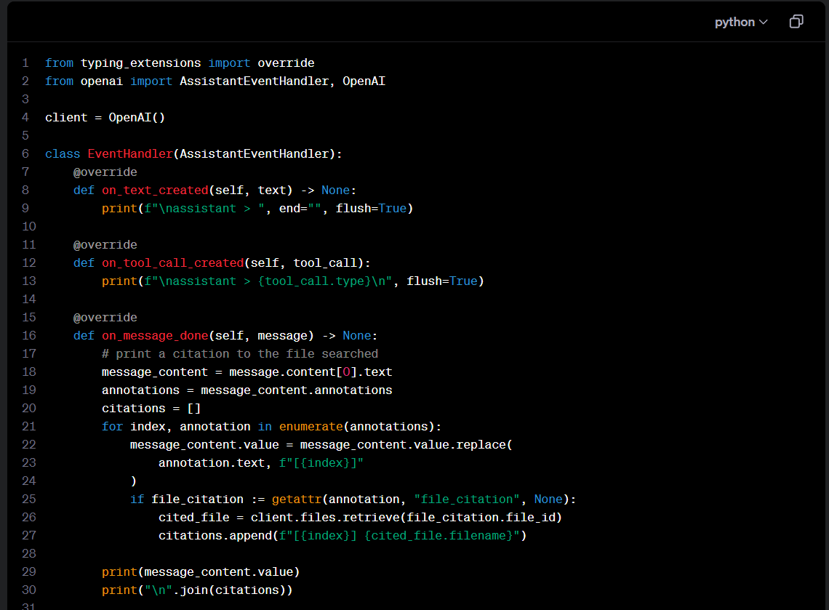
Stream Event Handler From the Documentation That Doesn’t Work
Notes:
https://platform.openai.com/docs/assistants/tools/file-search/step-5-create-a-run-and-check-the-output

Slide 8
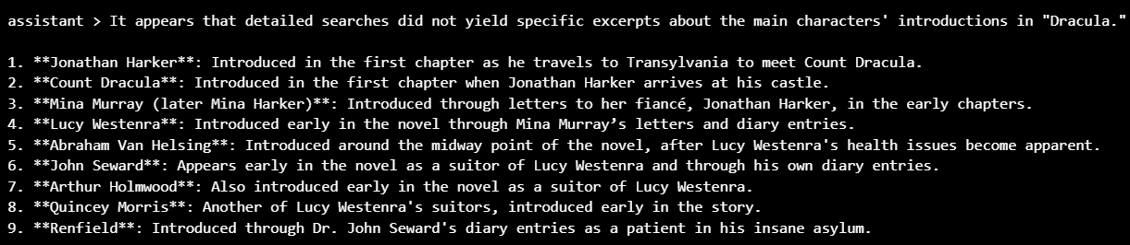
Demo: Streaming Output Based on Documentation

Slide 9



Notes:
https://www.youtube.com/channel/UC35ZpwldGw7ZJ5R-2sLijzw

Slide 10
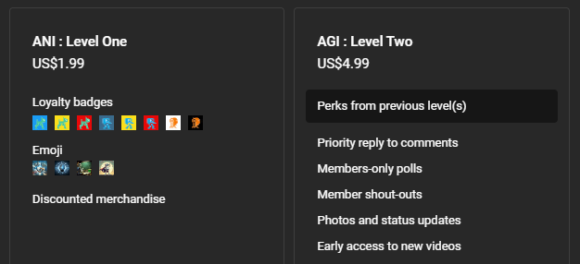
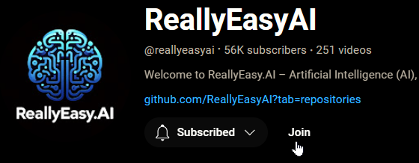
Membership has its privileges
Notes:
https://www.youtube.com/channel/UC35ZpwldGw7ZJ5R-2sLijzw/join

Slide 11
Updating the Event Handler
Let’s Create an Actual Streaming Event Handler

Slide 12
What is Different?
@override
def on_text_delta(self, delta, snapshot):
"""Handle the event when there is a text delta (partial text)."""
# Print the delta value (partial text) to the console
print(delta.value, end="", flush=True)
# Append the delta value to the results list
self.results.append(delta.value)
def on_tool_call_delta(self, delta, snapshot):
"""Handle the event when there is a delta (update) in a tool call."""
if delta.type == 'code_interpreter':
# Check if there is an input in the code interpreter delta
if delta.code_interpreter.input:
# Print the input to the console
print(delta.code_interpreter.input, end="", flush=True)
# Append the input to the results list
self.results.append(delta.code_interpreter.input)
# Check if there are outputs in the code interpreter delta
if delta.code_interpreter.outputs:
# Print a label for outputs to the console
print("\n\noutput >", flush=True)
# Iterate over each output and handle logs specifically
for output in delta.code_interpreter.outputs or []:
if output.type == "logs":
# Print the logs to the console
print(f"\n{output.logs}", flush=True)
# Append the logs to the results list
self.results.append(output.logs)

Slide 13
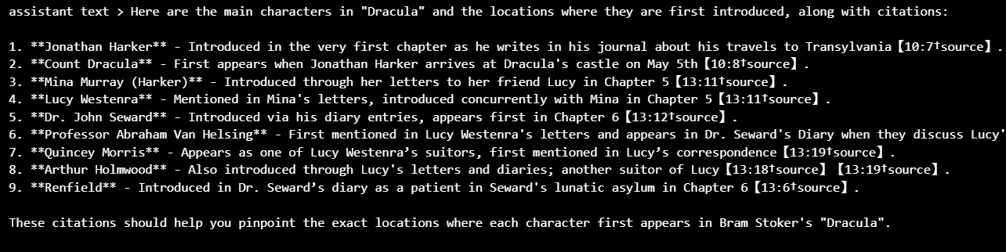
Demo: Streaming with the New Event Handler

Slide 14
Cleaning Up the Annotations
Breaking Down the Information Better
Notes:
https://platform.openai.com/docs/assistants/tools/code-interpreter/passing-files-to-code-interpreter

Slide 15
Demo: Cleaning Up the Annotations
# Extract the message content and annotations
message_text_object = message.content[0]
message_text_content = message_text_object.text.value # Access the value attribute for the actual text
annotations = message_text_object.text.annotations # Access annotations directly
# Print the annotations in a cleaner format
for index, annotation in enumerate(annotations):
print(f"Annotation {index + 1}:")
print(f" End Index: {annotation.end_index}")
print(f" Start Index: {annotation.start_index}")
print(f" Text: {annotation.text}")
print(f" Type: {annotation.type}")
if hasattr(annotation, 'file_citation'):
file_citation = annotation.file_citation
print(f" File Citation:")
print(f" File ID: {file_citation.file_id}")
print("") # Add a blank line for readability

Slide 16
Final Thoughts
There is No Fate But What You Make
Notes:
https://platform.openai.com/docs/assistants/tools/code-interpreter/passing-files-to-code-interpreter

Slide 17
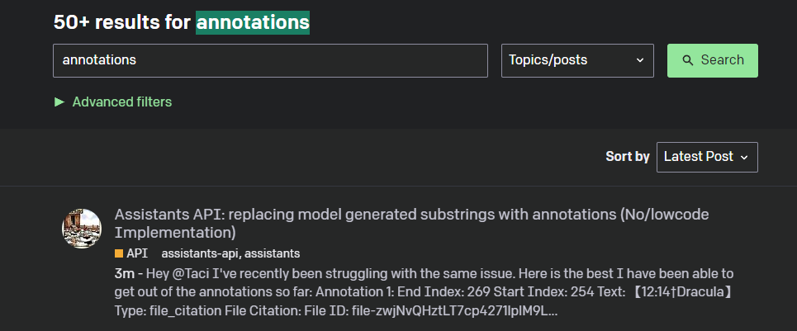
Annotations Are a Work in Progress
Notes:
https://community.openai.com/search?q=annotations%20order%3Alatest

Slide 18


